Slide 1

WEBSITE WITH FACE RECOGNITION LOGIN SYSTEM
WITH VOICE TO SEARCH DATA
Processed by:YASH BISHT
(B.TECH-CSE-2018872-G)

Slide 2
ABOUT
Face recognition in python: An algorithm notes certain essential elements on a face— color of eyes, the slant of the nose, the shape of the chin, and other apt things that help discern a face. Then, this information obtained identifies a particular face. “Face encodings” also help make this identification.
Voice recognition: JavaScript provides us with methods to enable speech recognition with Web Speech API. This API acts as a controller in the interface for the recognition service, along with an event handler called SpeechRecognition which fires the event
This project is currently used to search information of students of B.Tech with a voice search functionality.
It uses face ID of the user to allow them to login.
It has two main components:

Slide 3
Project System Requirements
Python version 3.5 or above installed in the system.
Python libraries like open cv, numpy, OS, PIL, flask, save, face_recognition and datetime.
Webcam and microphone must be present.
Operating System : Windows 7,8,10,11/Linux/Mac-os.
Minimum 2 GB of RAM required.
Any dual core processor can be used.
Minimum of 2 GB storage required.

Slide 4
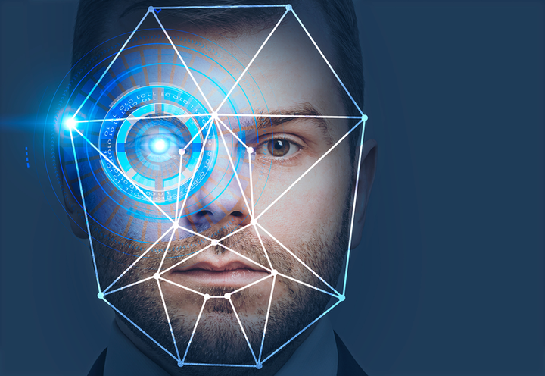
Modules &Libraries Used:
Numpy
Date & Time
PIL
Open CV
It is a library of Python bindings designed to solve computer vision problems.
NumPy is a Python library used for working with arrays.
For storing and reading data and displaying time.
Face_recognition
Recognize and manipulate faces from Python or from the command line.
The Python Imaging Library or PIL is an amazing Python library used for image processing.

Slide 5
ALGORITHM USED
Face recognition login uses following algorithms:
Haar-Cascade Detection:
It is an Object Detection Algorithm used to identify faces in an image or a real time video. The algorithm is given a lot of positive images consisting of faces, and a lot of negative images not consisting of any face to train on them. The models are stored in XML files, and can be read with the OpenCV methods. These include models for face detection, eye detection, upper body and lower body detection, license plate detection etc.

Slide 6
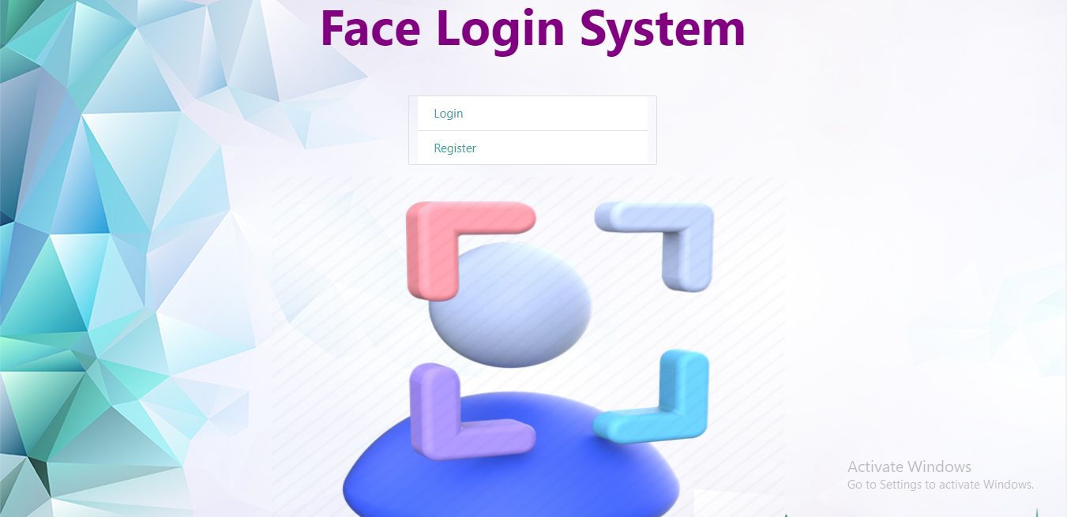
FEATURES:
Easy to use and user friendly with interactive GUI support.
Password protection for new person registration.
Login using face ID
Provides voice search feature.
Displays the details of students in tabular format for easier interpretation.

Slide 7
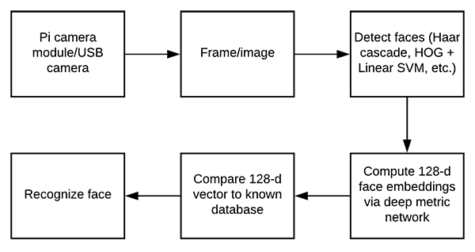
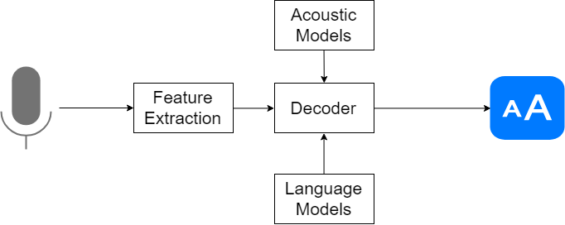
BIG IMAGE
F
L
O
W
C
H
A
R
T

Slide 8
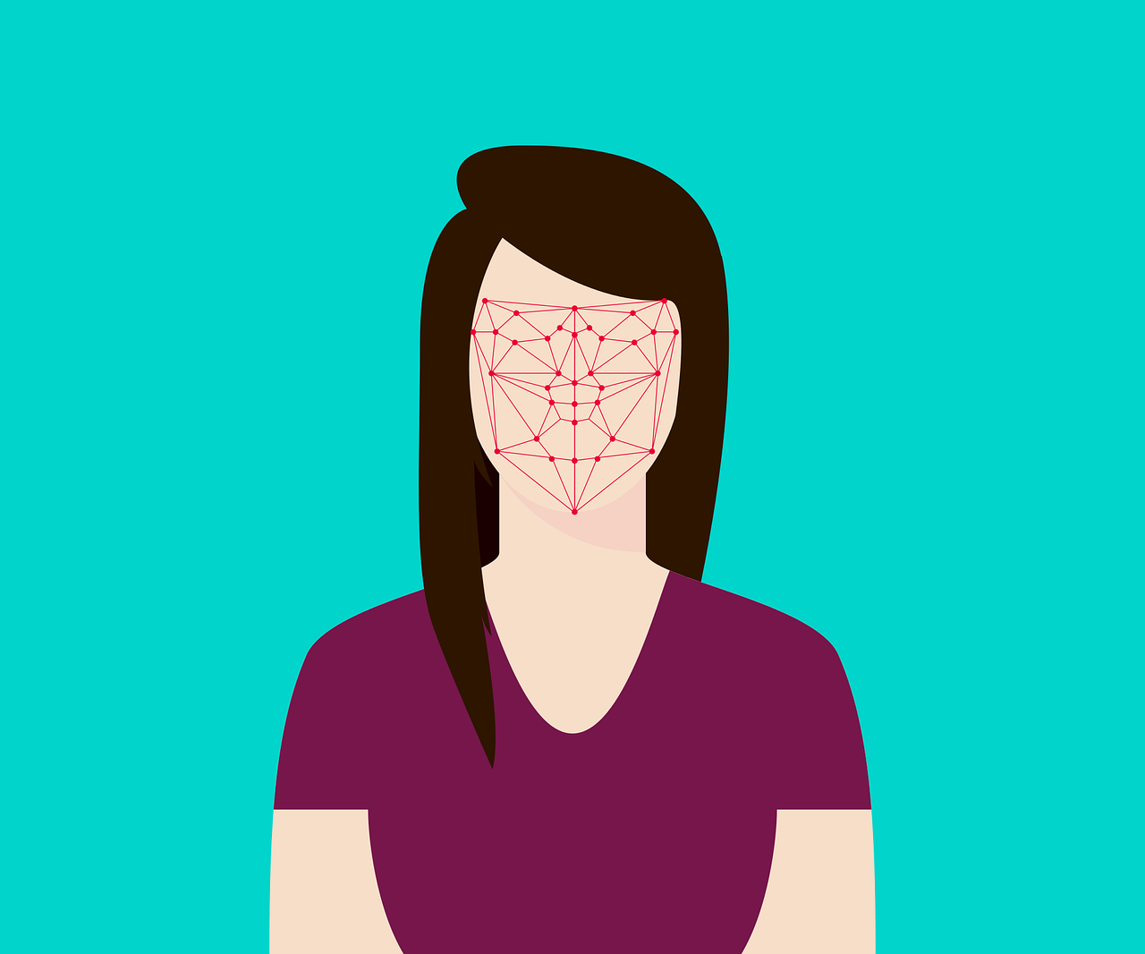
THANK YOU!

